Slide 1
軟工期末專案
Team 5
組員:
許中昱 鄭丞佑
蘇歆芳 許書瑜
尤仲平 謝承展
吳軒毅 潘冠妤

Slide 2
CONTENTS
資料表設計
User UI 介紹
Team UI 介紹
Game UI 介紹
DEMO

Slide 3
1.
資料表設計

Slide 4
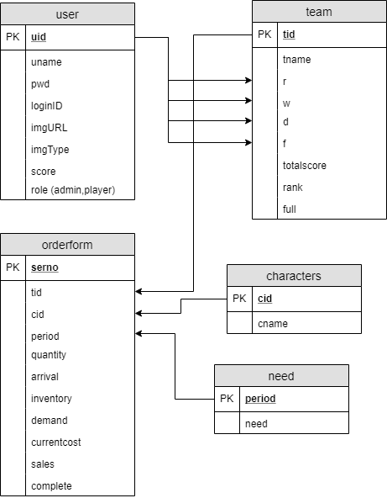
Hello!

Slide 5
2.
User UI 介紹

Slide 6
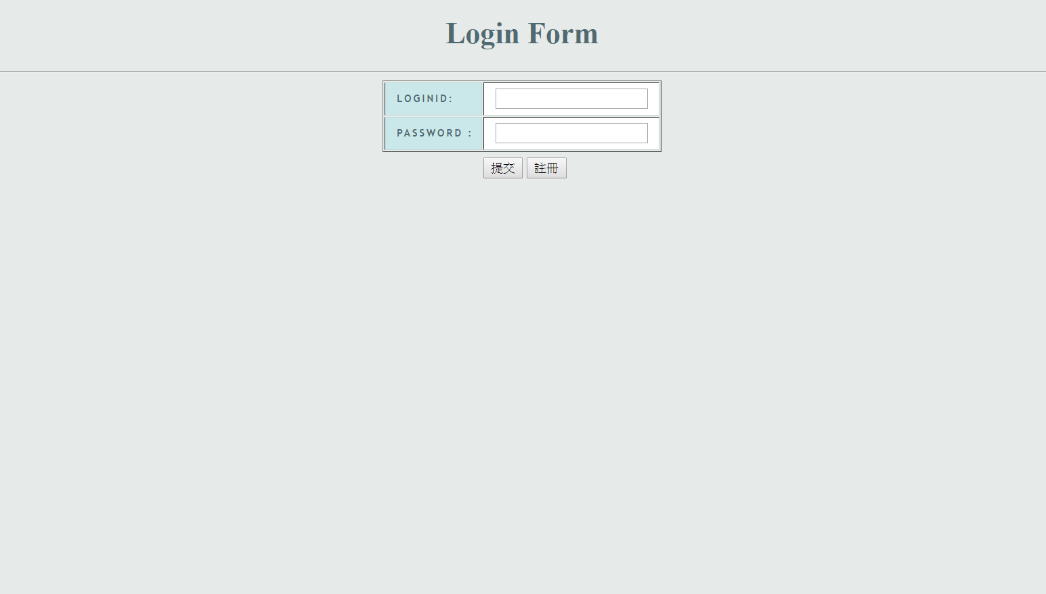
Quotations are commonly printed as a means of inspiration and to invoke philosophical thoughts from the reader.

Slide 7
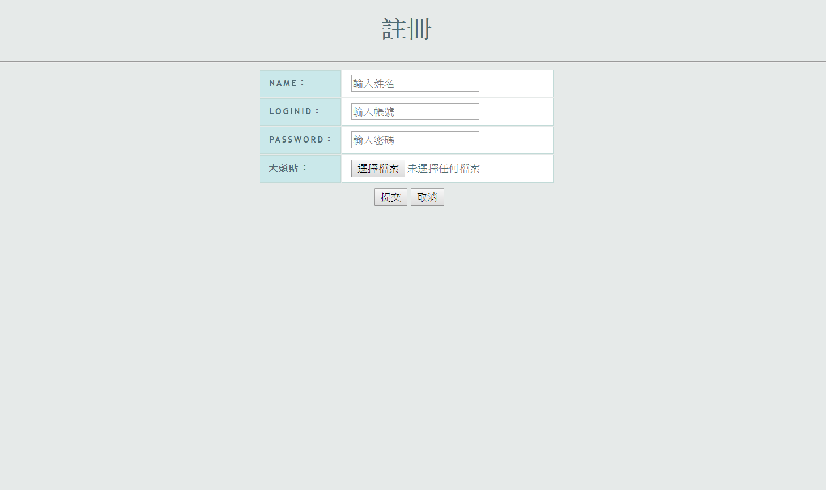
This is a slide title
Here you have a list of items
And some text
But remember not to overload your slides with content
Your audience will listen to you or read the content, but won’t do both.

Slide 8
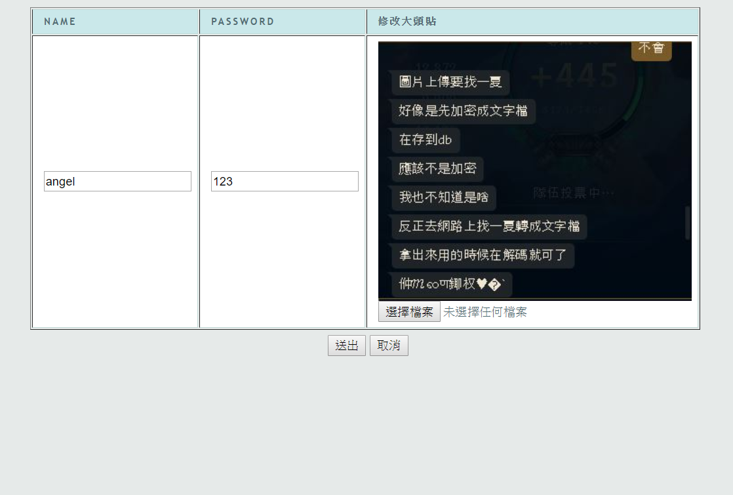
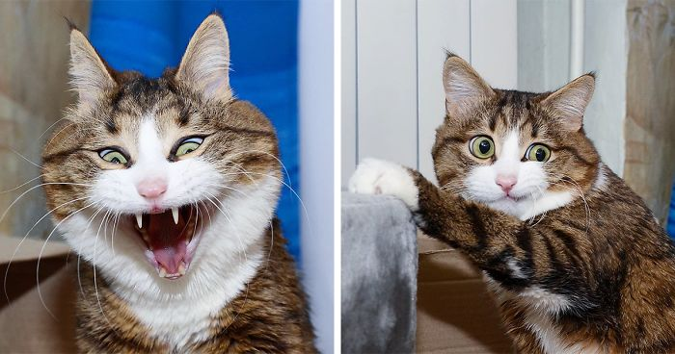

Slide 9
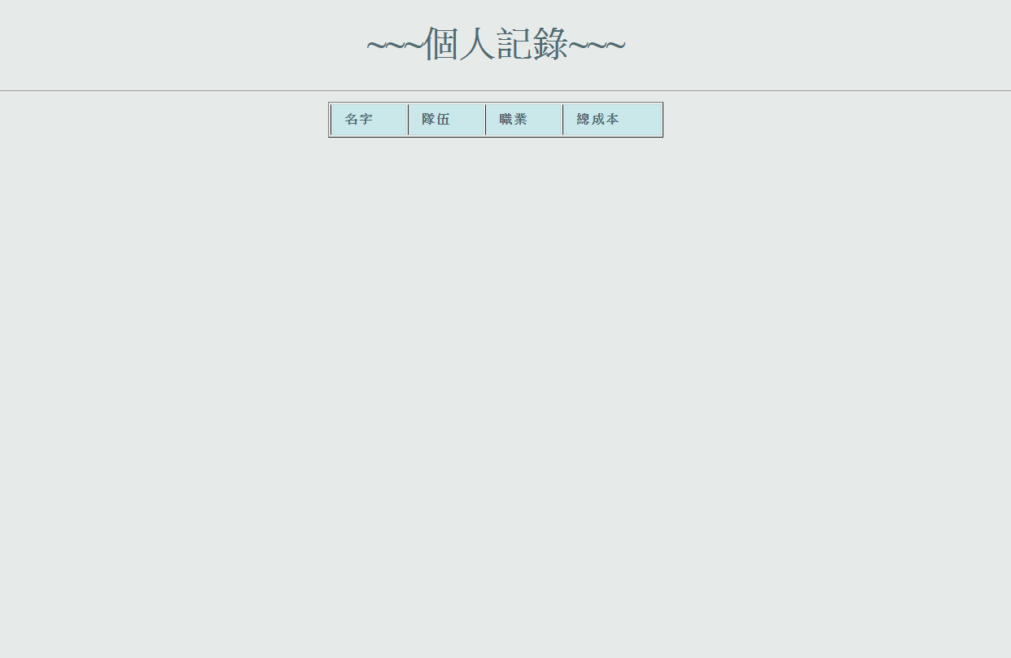

Slide 10
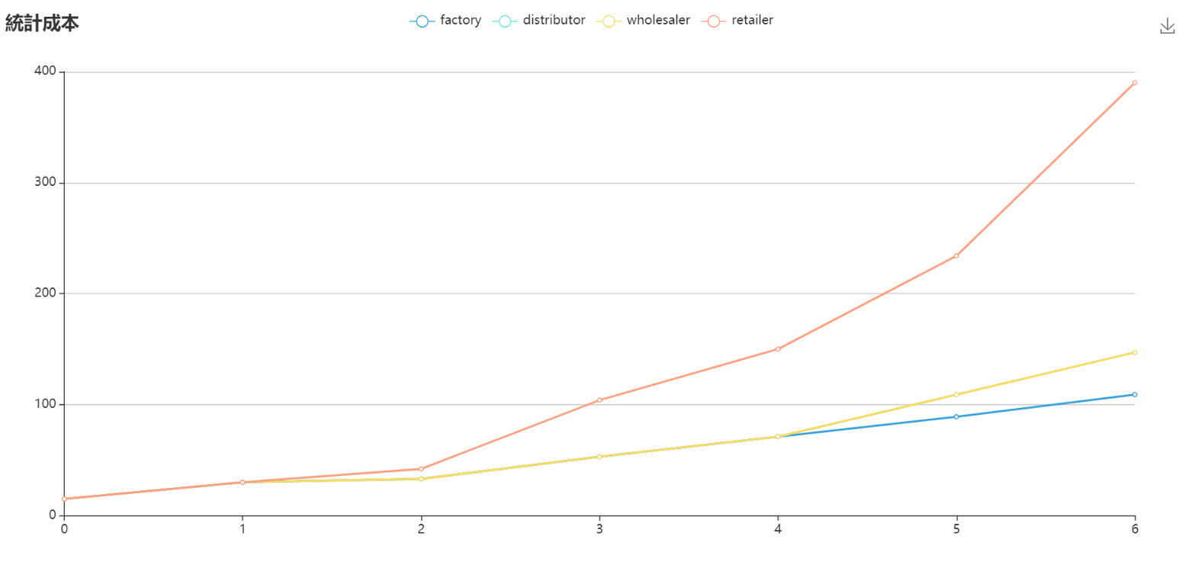

Slide 11
3.
Team UI 介紹

Slide 12
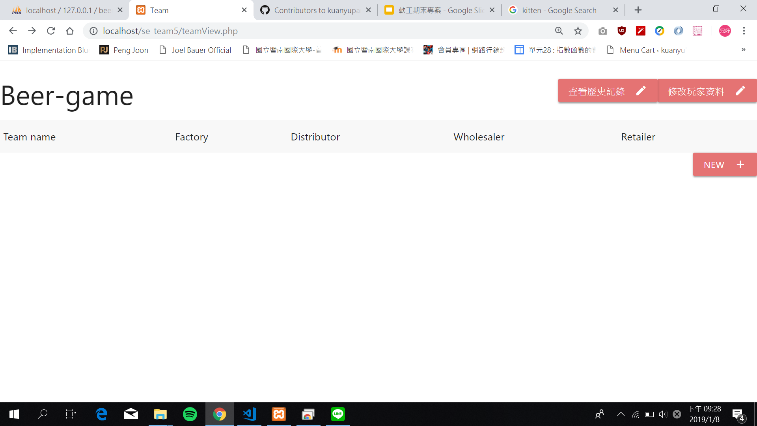
User

Slide 13
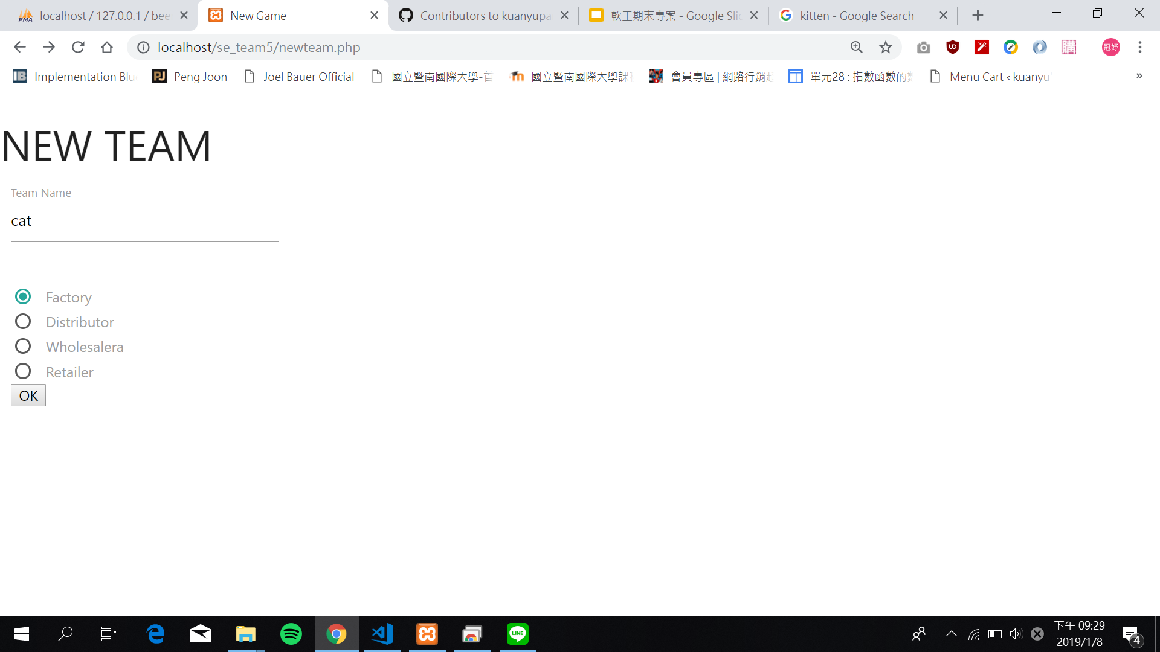
New Team

Slide 14
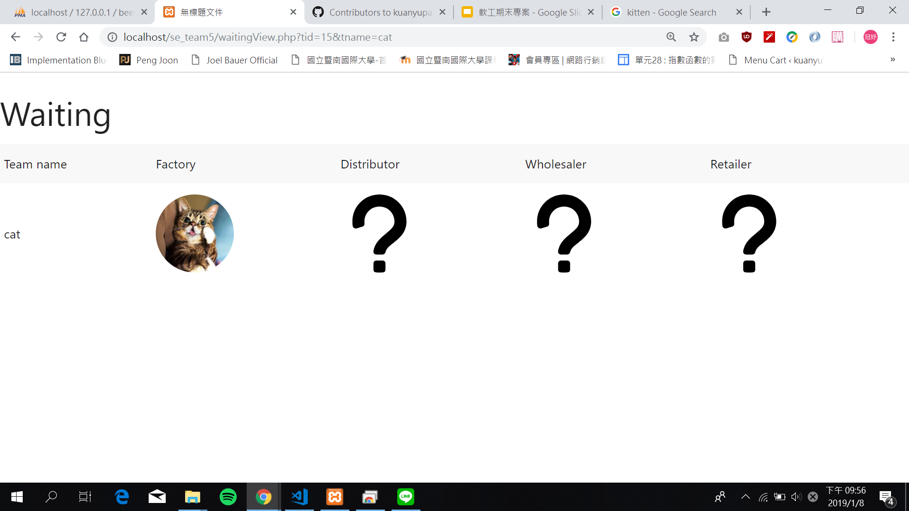
Waiting

Slide 15
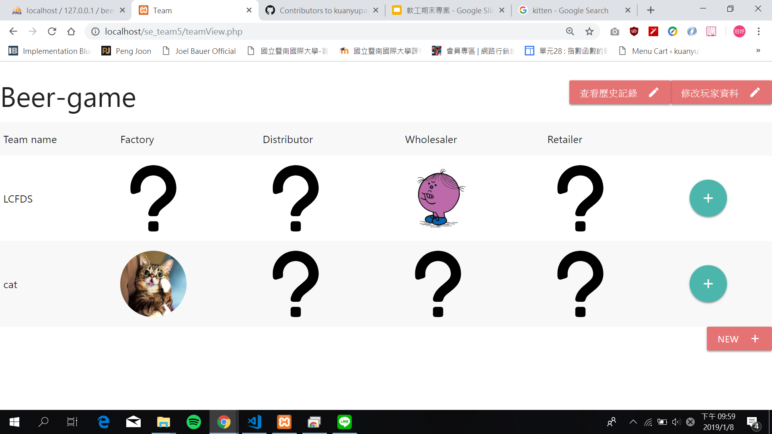
Add to Team

Slide 16
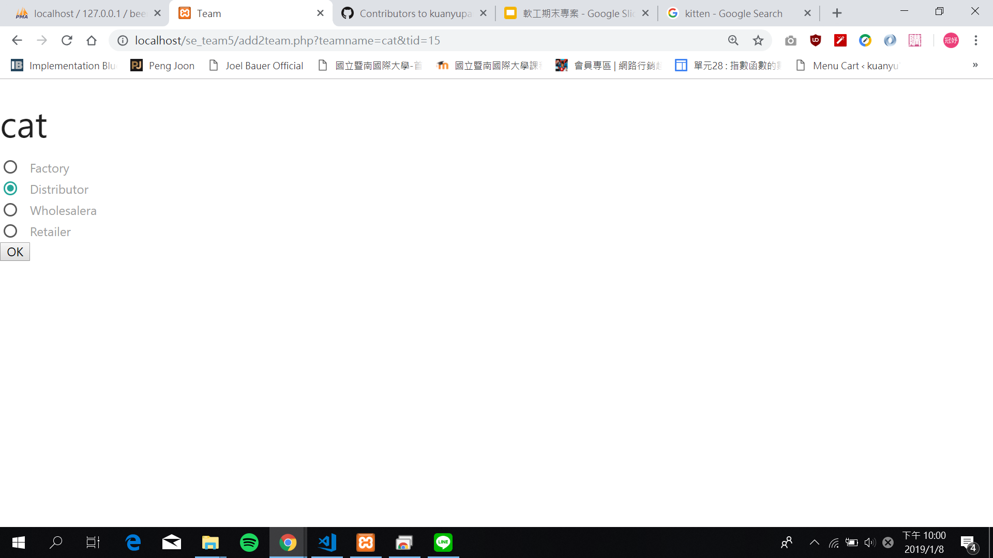
Add to Team

Slide 17
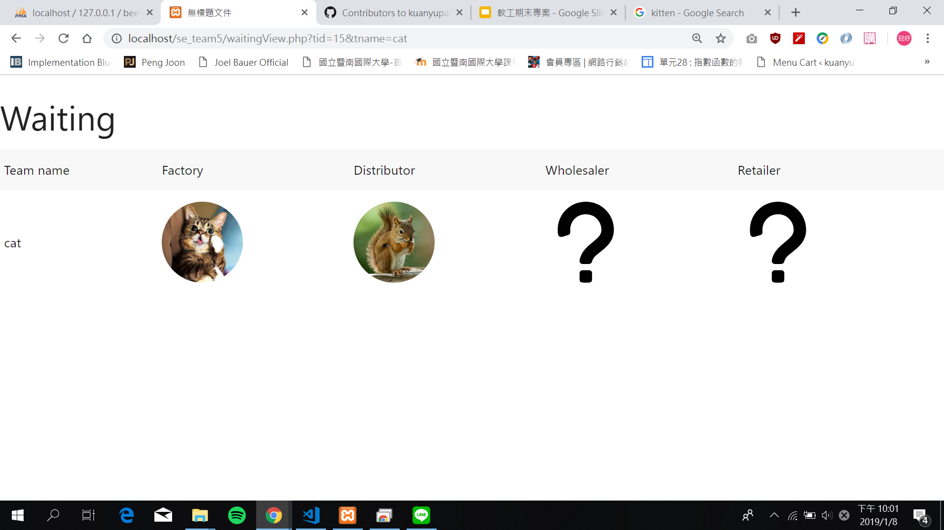
Waiting

Slide 18
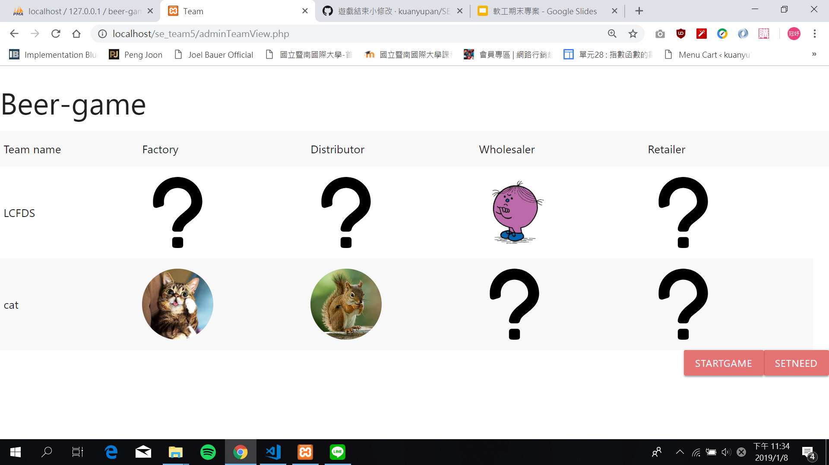
Admin

Slide 19
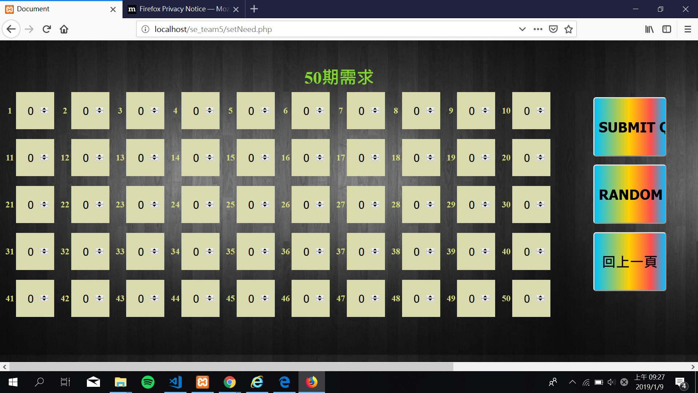
Set Need

Slide 20
4.
Game UI 介紹

Slide 21
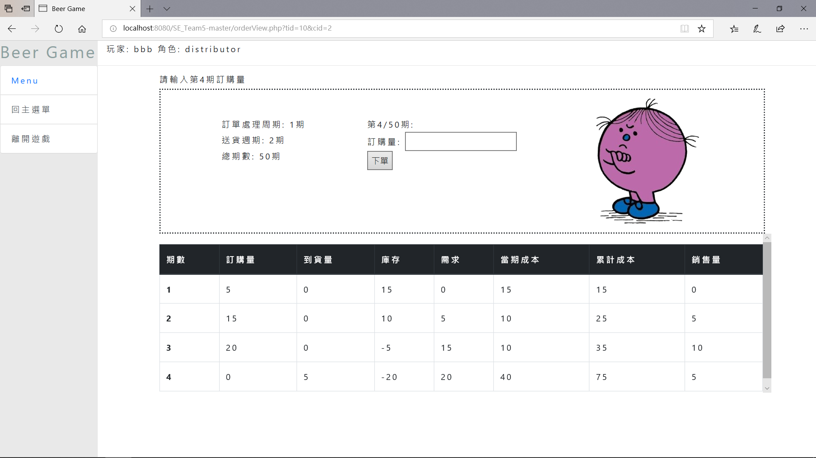
play

Slide 22

Waiting

Slide 23
5.
DEMO

Slide 24
THANKS!

